Slide 1
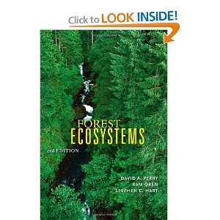
Anik Niraj Desai Roll No : 184

Slide 2
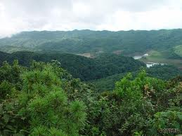
Forest Ecosystem
Forest ecosystems are dominated by trees that can mature to at least 2 metres in height and provide a canopy of at least 20% cover, together with all the native wildlife, including birds, mammals, insects, plants, as well as fungi, micro-organisms and non-living things such as water, soil and air interacting within the same area.

Slide 3
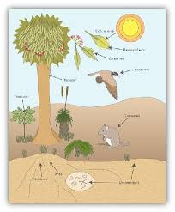
Role Of Organisms In Forest Ecosystem
A community of organisms living in a forest ecosystem depend on each other through a complex series of interacting relationships called food webs.
These complex food webs are dependent on simpler food chains.
Both food webs and food chains are characterised by the transfer of energy originating from the sun.

Slide 4
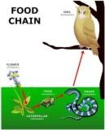
In a food chain, the transfer if energy begins with the producer and ends with the highest order consumer, as follows:
plant → insect → frog → snake→ owl

Slide 5
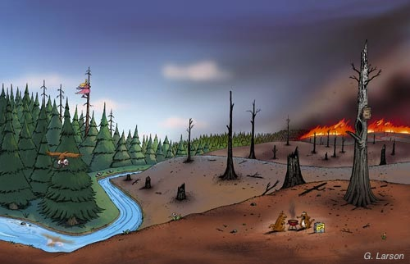
Role Of Forest Ecosystem in Sustainability
Forest ecosystems play a crucial role in sustainability through the efficient capture and conversion of energy from the sun and its storage into plant material.
This plant material provides food, energy and fibre for other organisms, including humans that rely on timber and non-timber forest products in their everyday lives.
However, forests must be managed properly to support the sustainable long term capture and supply function.

Slide 6
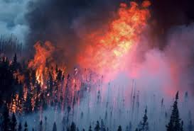
Impact Of Human Activities & Natural Forces On The Forest Of India
Clearing and burning of the forests for agriculture,cattle rearing and timber extraction.
Clear cutting and conversion of forest land in hilly areas for agriculture,plantation and housing.
Forests affected by acid deposition originating from industries.
Pesticides spraying to control insects in forest plantation leads to poisoning all the way up the food chain and unintended loss of species.

Slide 7
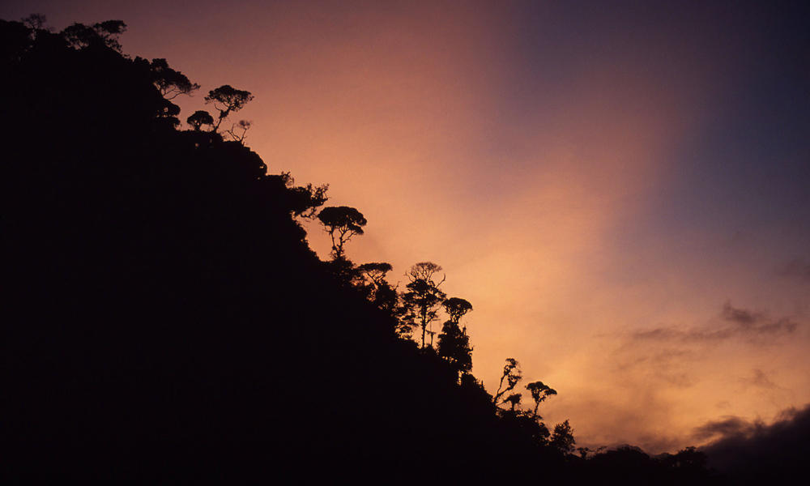
Dams build in forest areas for hydropower and water drown huge areas ,destroying species and depriving people of their land.
In wilderness areas like the Arctic ,oil exploration and military activities disrupt the ecosystem ,contaminating areas and lead to decline of species.
The harvesting of old growth forests destroys crucial habitat for endangered species.

Slide 8
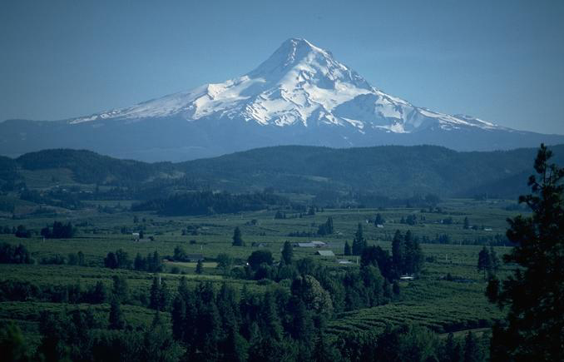
Thank You

